Slide 1


GUSA, Batman, and the Budget: A presentation in Three Acts

Slide 2
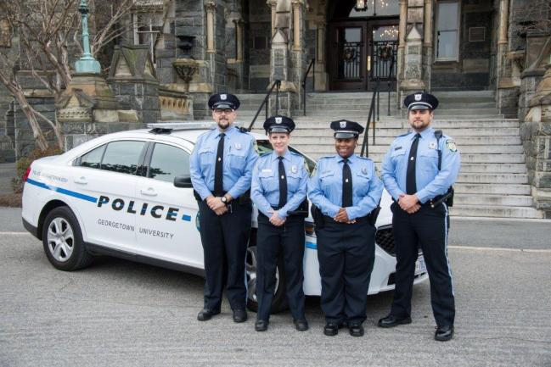
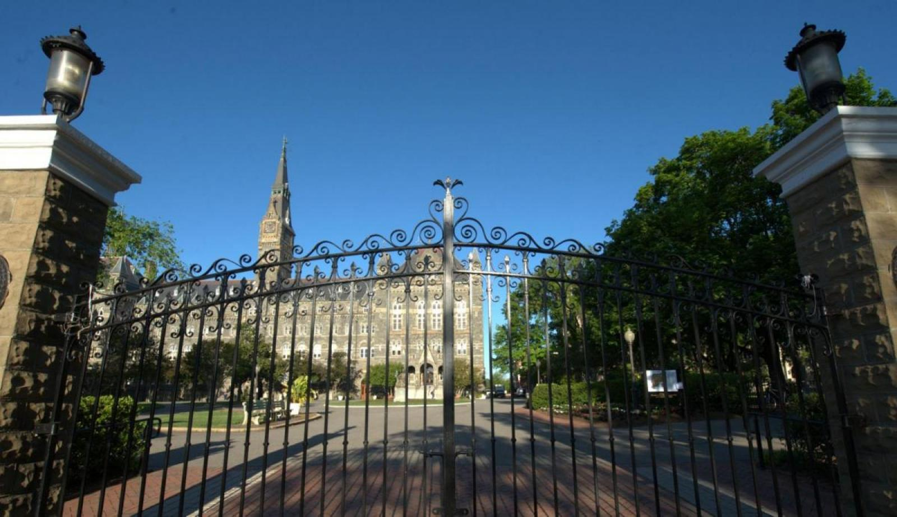
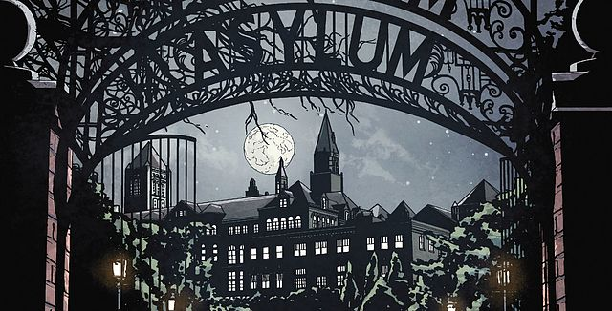

ACT I: Ridiculous Proposals
Notes:
Project Arkham: Get the front gates to have the words “Arkham Asylum” on them (we’re not the only ones that see the similarities, right?)
Project Justice: Replace GUPD with highly trained vigilantes

Slide 3

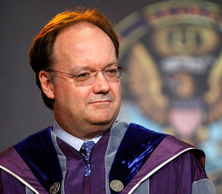
ACT II: Literally Everyone Rejects those Proposals
No Logan you can’t have money for those things. I’m going to Tombs now.
These proposals are making me seriously reconsider my life’s work

Slide 4
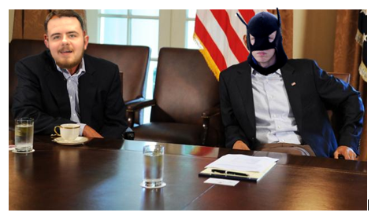
ACT III: The Money stays the Same
Cut current GUSA budget by 2.6% ($500)
Proposed $350 cut from discretionary accounts
Remaining $150 to be cut from programs that could get money elsewhere
All General Account funds not earmarked to allow for Senate input (except GUSA Fund)
GUSA has resources, money isn’t one of them
Pictured right: Speaker Baldwin and President Batman deliberate over discretionary funds

